Slide 1
How is Money Created?
Team 3
August
2026

Slide 2
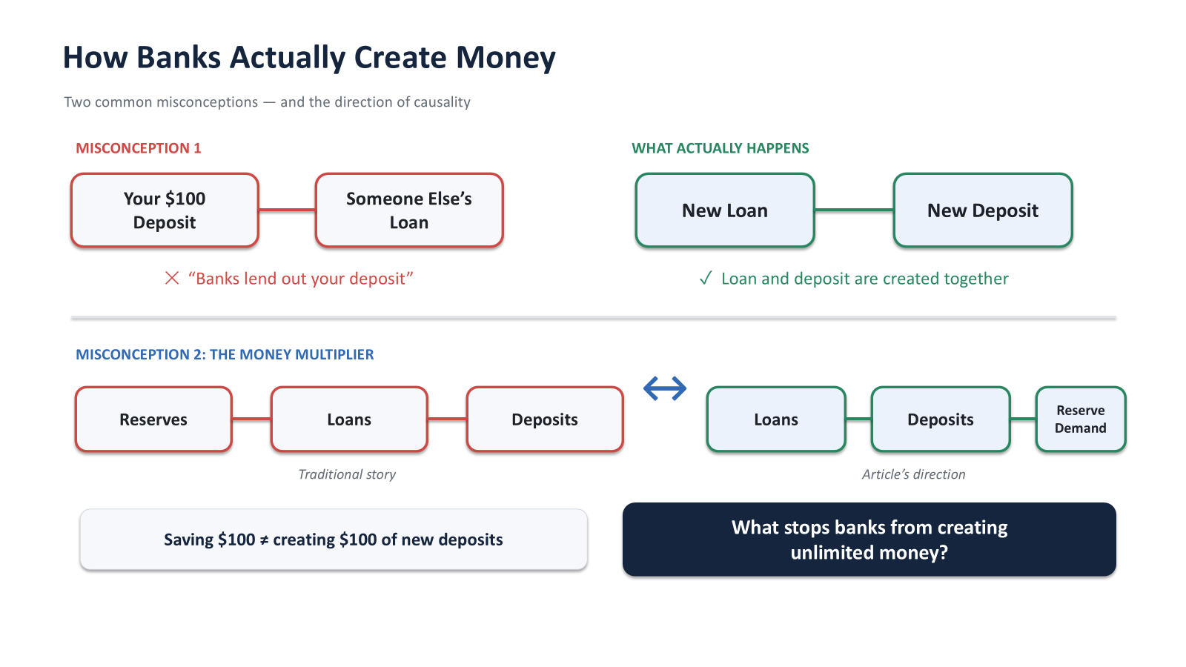
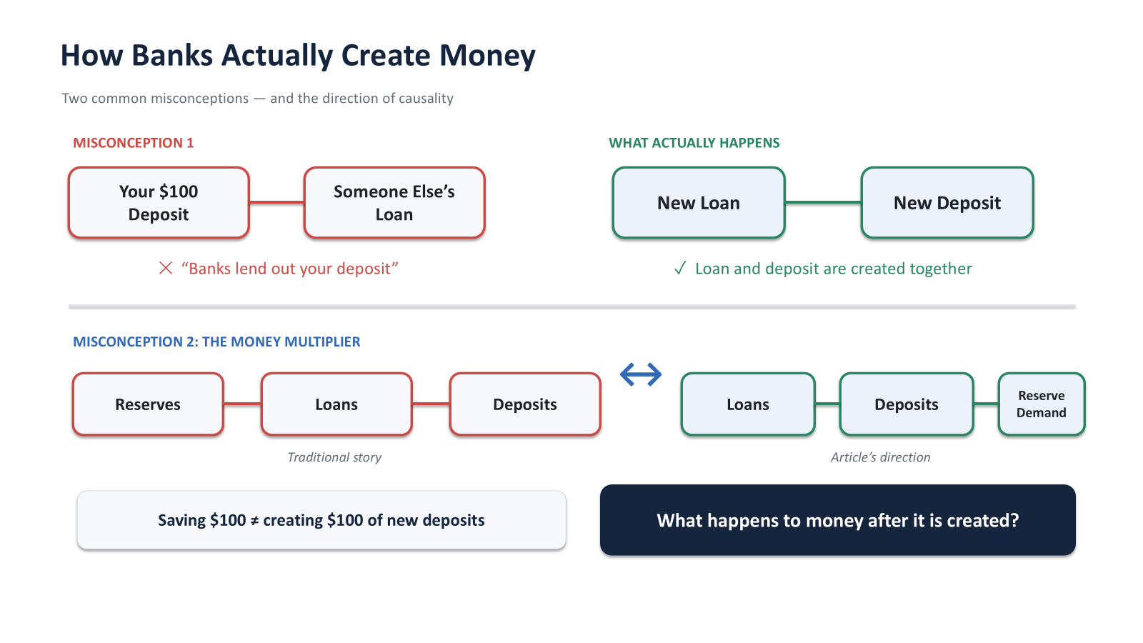

Slide 3
How Commercial Banks Create and Destroy Money
Borrower
Commercial Bank
+ £10,000 Deposit
Money Destruction
The Reverse Process:
Loan repayment
→ Deposit disappears
→ Broad money ↓
COMMERCIAL BANK BALANCE SHEET
Assets
Liabilities
+ £10,000 Loan (Borrower debt)
+ £10,000 Deposit (New money)
Repayment destroys deposits, shrinking the overall money supply as debts are settled.
New loan → New deposit → Broad money ↑
Base money does not initially change. Central bank reserves are primarily held by commercial banks and used to settle payments between them.

Slide 4
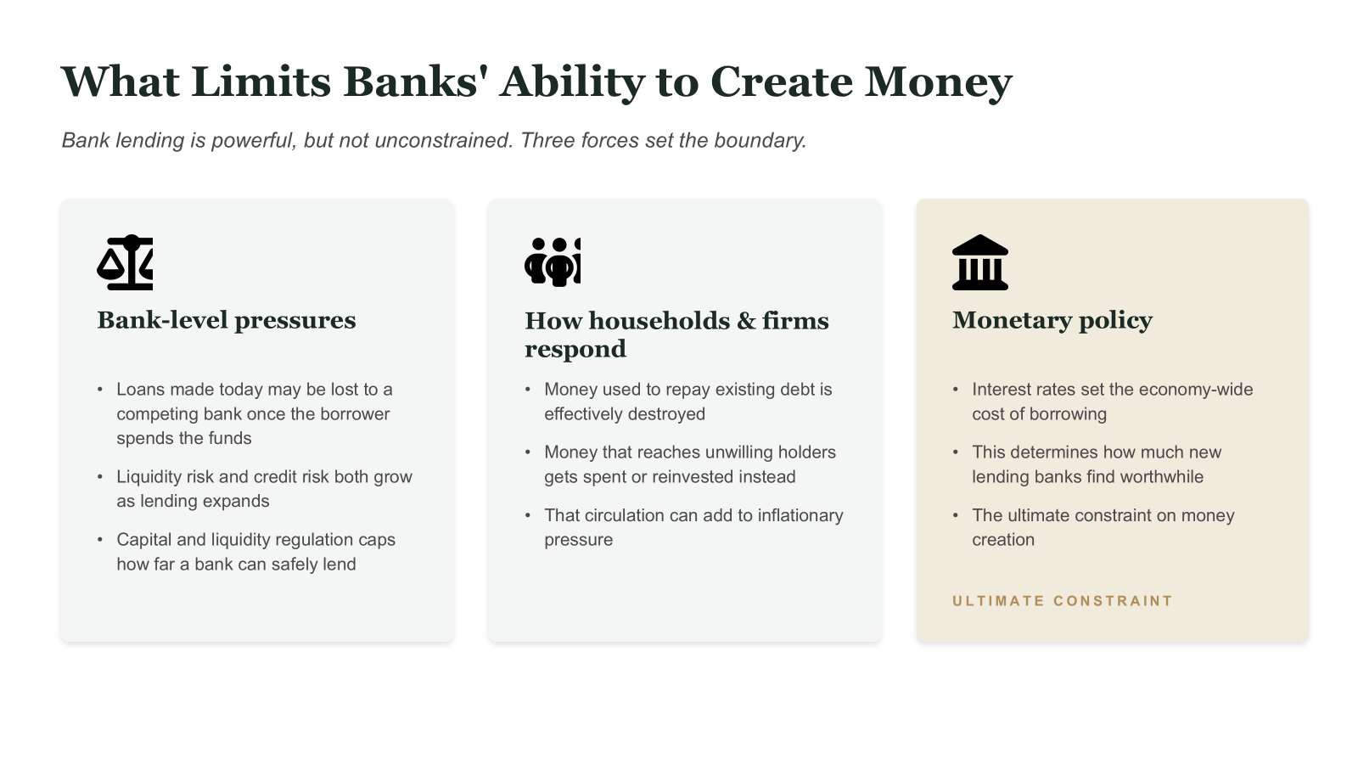

Slide 5
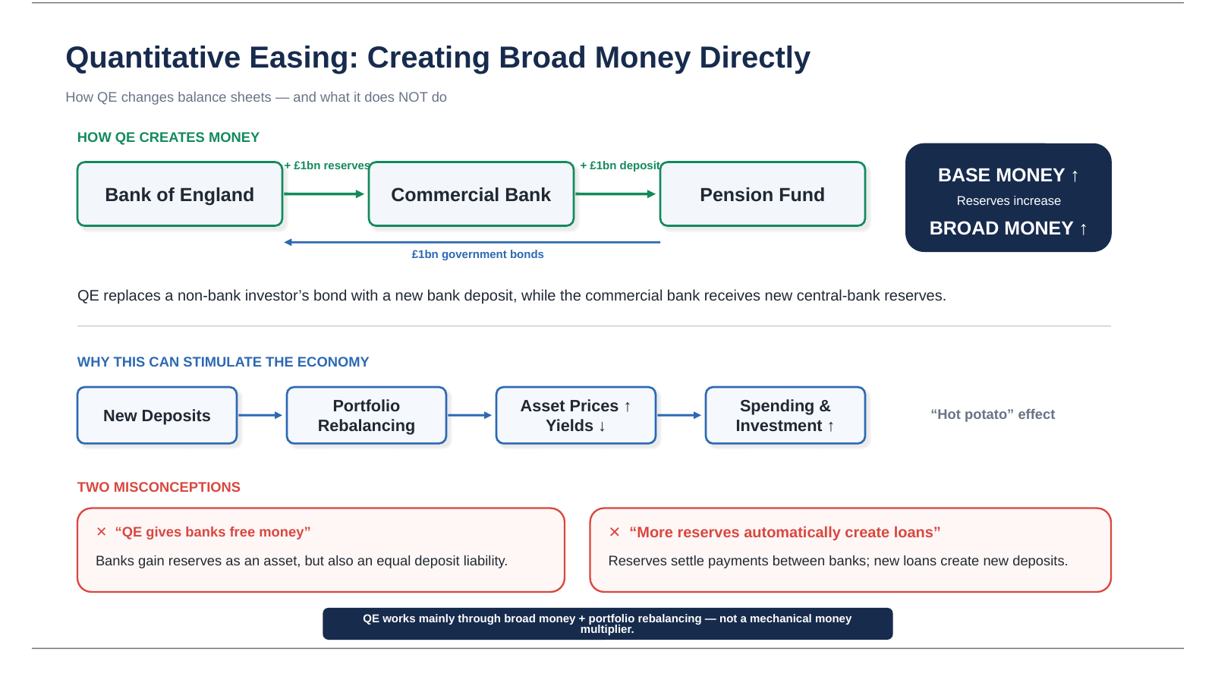

Slide 6
Thank you for listening

